Slide 1



PIZZA SALES ANALYSIS USING SQL
- Sneha Kumari
-SnehaKumari

Slide 2
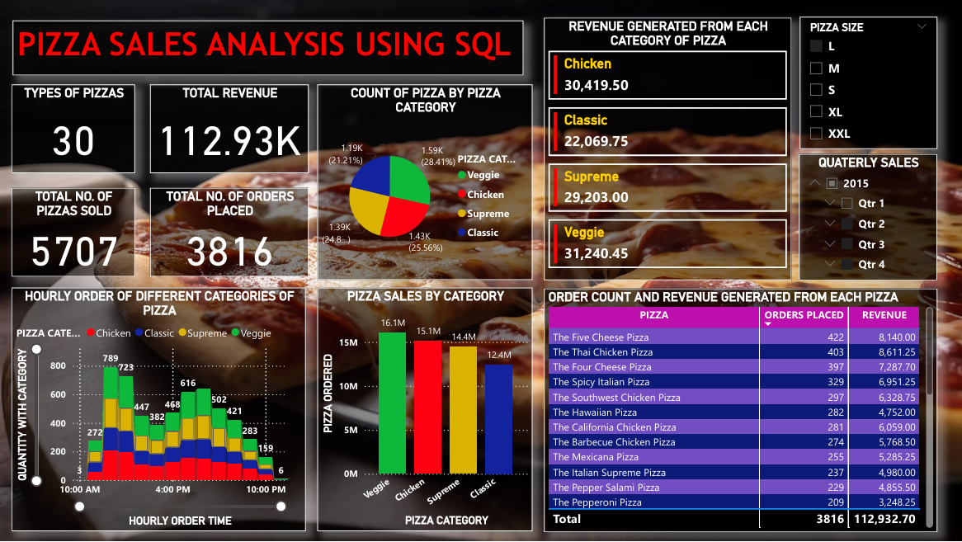
POWER BI DASBOARD

Slide 3


CONTENTS
Dataset Used
Schemas
Total Orders
Total Revenue
Most expensive pizza
Most common pizza ordered
Join the necessary tables to find the total quantity of each pizza category ordered.
Determine the distribution of orders by hour of the day
Join relevant tables to find the category-wise distribution of pizzas
Determine the top 5 most ordered pizza types based on revenue.
Calculate the percentage contribution of each pizza type to total revenue
Analyze the cumulative revenue generated over time
Determine the top 3 most ordered pizza types based on revenue for each pizza category
-SnehaKumari

Slide 4

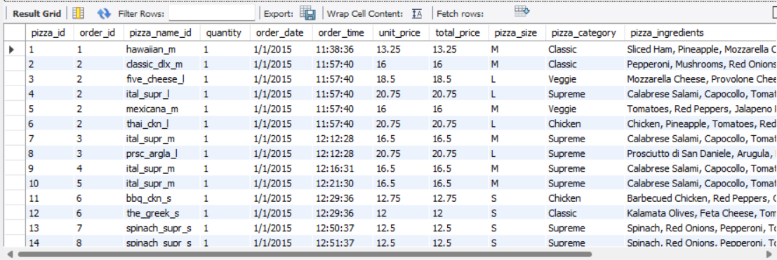
DATASET USED
-SnehaKumari

Slide 5
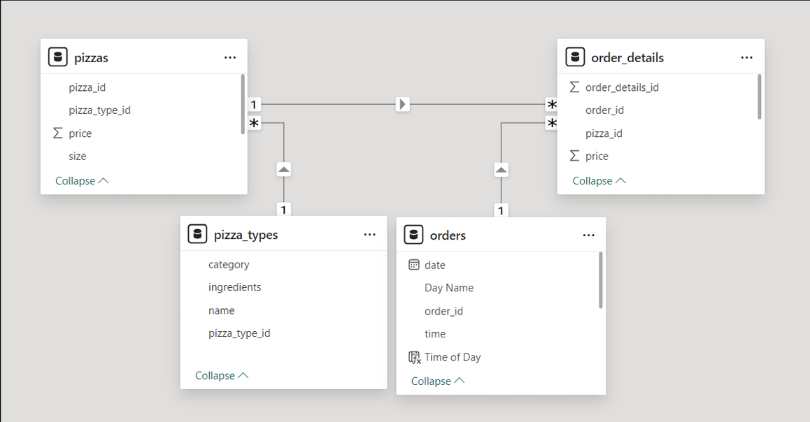
SCHEMAS
-SnehaKumari

Slide 6

TOTAL ORDERS
-SnehaKumari

Slide 7


TOTAL REVENUE
-SnehaKumari

Slide 8
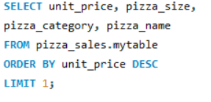

Most Expensive Pizza
-SnehaKumari

Slide 9
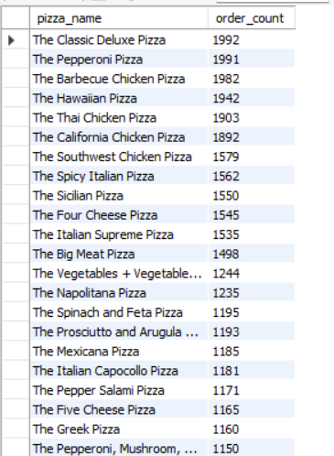
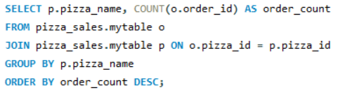
Most Common Pizza Ordered
-SnehaKumari

Slide 10
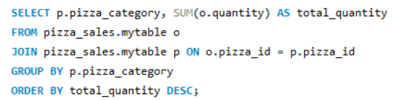
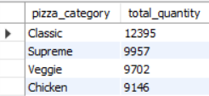
Join the necessary tables to find the total quantity of each pizza category ordered.
-SnehaKumari

Slide 11
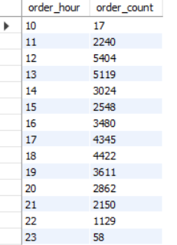
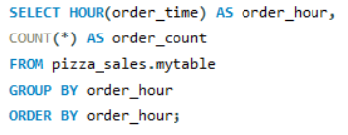
Determine the distribution of orders by hour of the day
-SnehaKumari

Slide 12
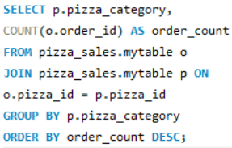
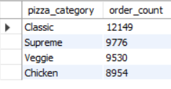
Join relevant tables to find the category-wise distribution of pizzas
-SnehaKumari

Slide 13
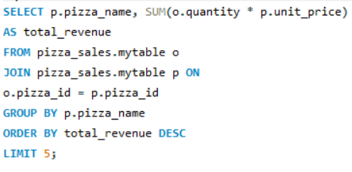
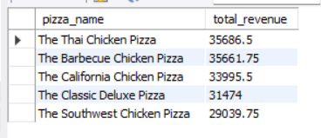
Determine the top 5 most ordered pizza types based on revenue.
-SnehaKumari

Slide 14
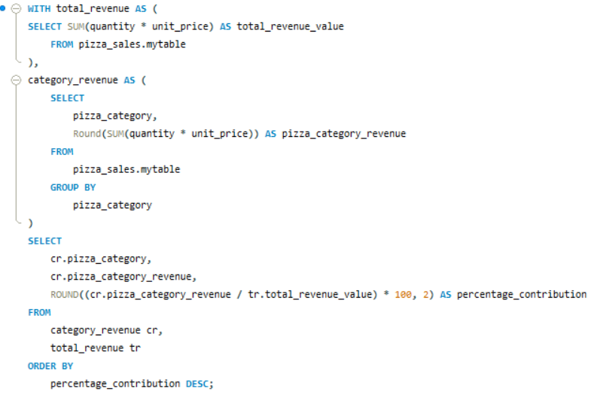
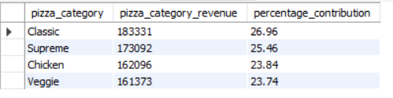
Calculate the percentage contribution of each pizza type to total revenue
-SnehaKumari

Slide 15
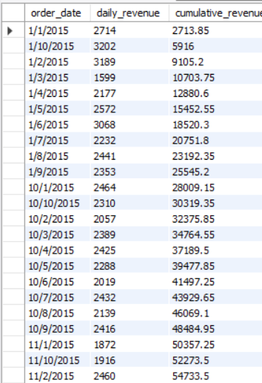
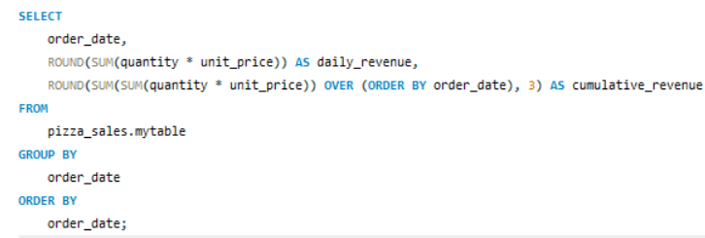
Analyze the cumulative revenue generated over time
-SnehaKumari

Slide 16
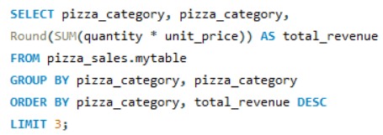
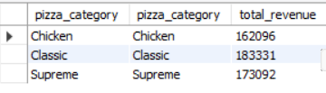
Determine the top 3 most ordered pizza types based on revenue for each pizza category
-SnehaKumari

Slide 17

thanks!
- Sneha Kumari
-SnehaKumari

